Slide 1
MS-101: ME Lecture-2 Solid Modeling
Digital prototype of actual product consisting of parts and sub-assemblies
(Reference: Chapter # 5, Lieu & Sorby)
Date: Mar 18, 2023
Instructor: Ankit Jain

Slide 2
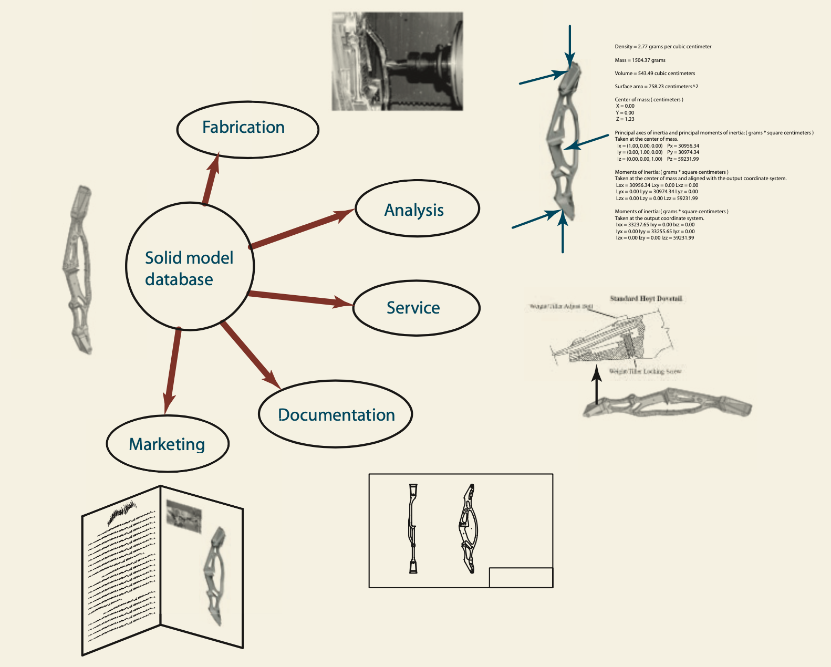
Solid Modeling
Computer based simulation that provides a visual display of an object as if it existed in three dimensions

Slide 3
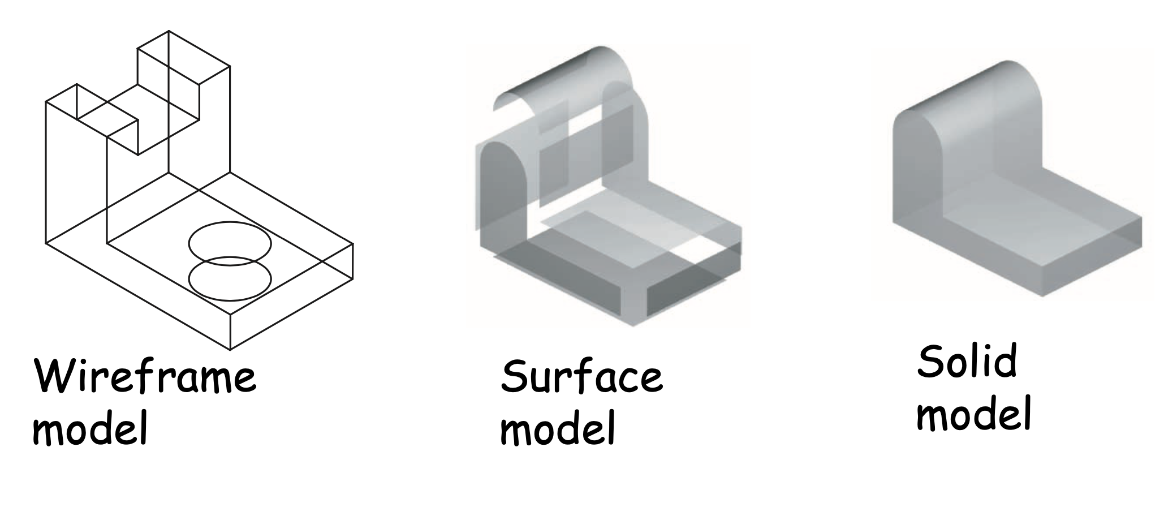
3D-Models
Solid models contain information about the outside as well as inside of a part

Slide 4
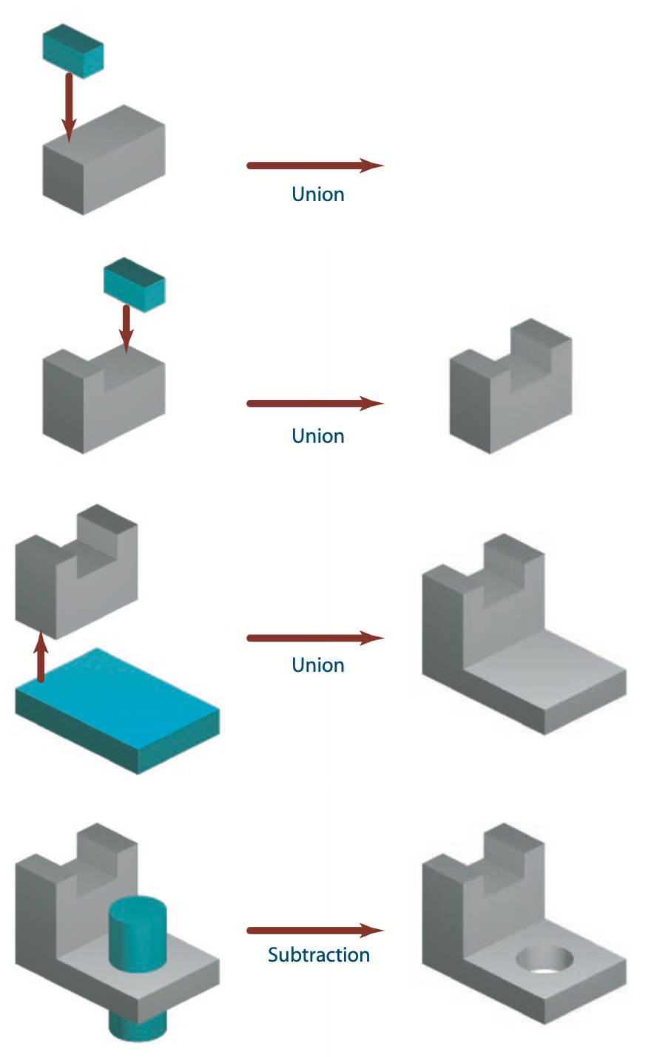
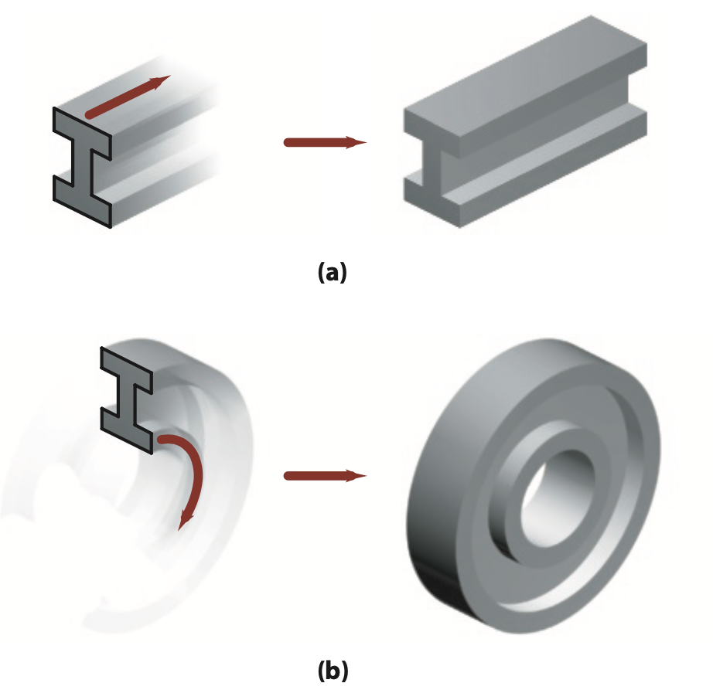
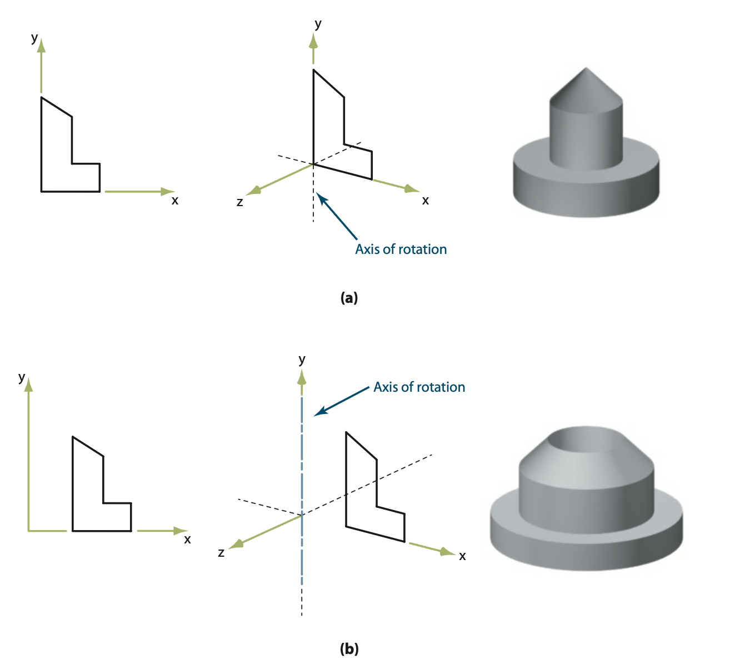
Creating Complex 3D-objects
Using 2D-sketches: (a) extrusion (b) revolve
Revolve
Combining existing objects

Slide 5
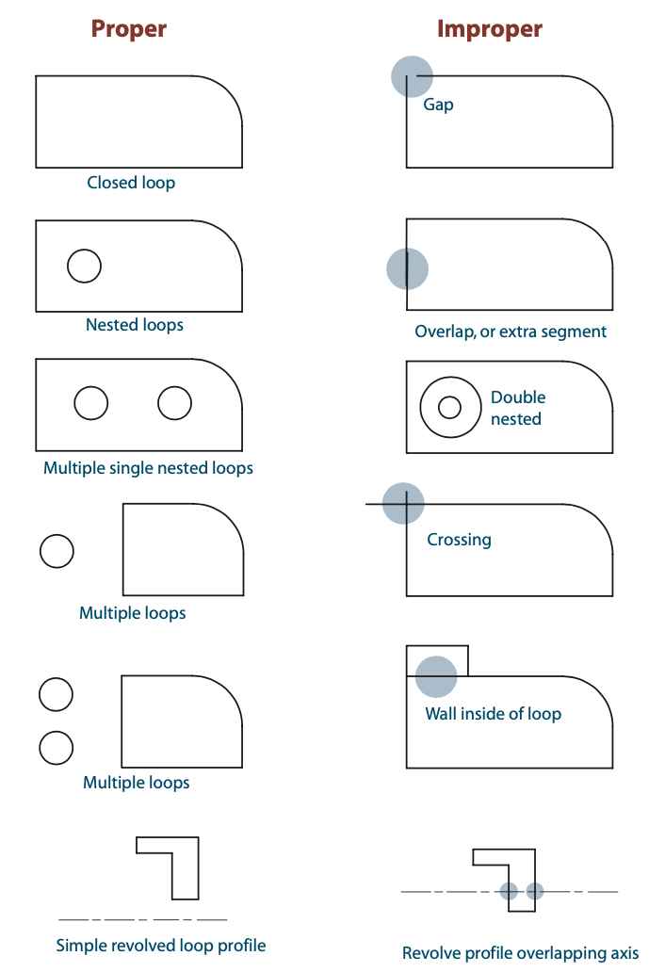
Proper and Improper Profiles
Valid profiles must be
closed loops

Slide 6
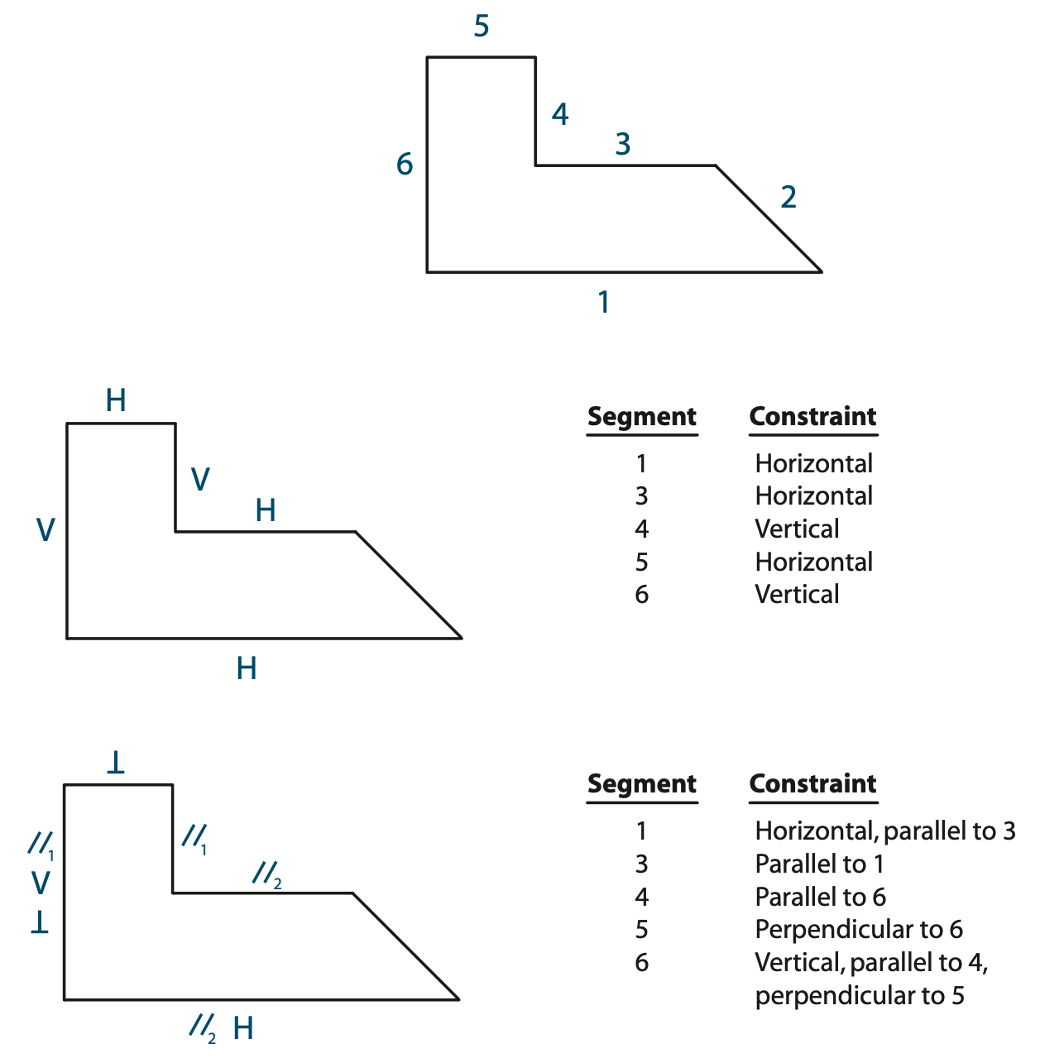
Making Precise Profiles – Constraints
Constraints are geometric relationships, dimensions or
equations that control the size, shape of entities in the profile sketch
Geometric Constraints
- Not unique

Slide 7
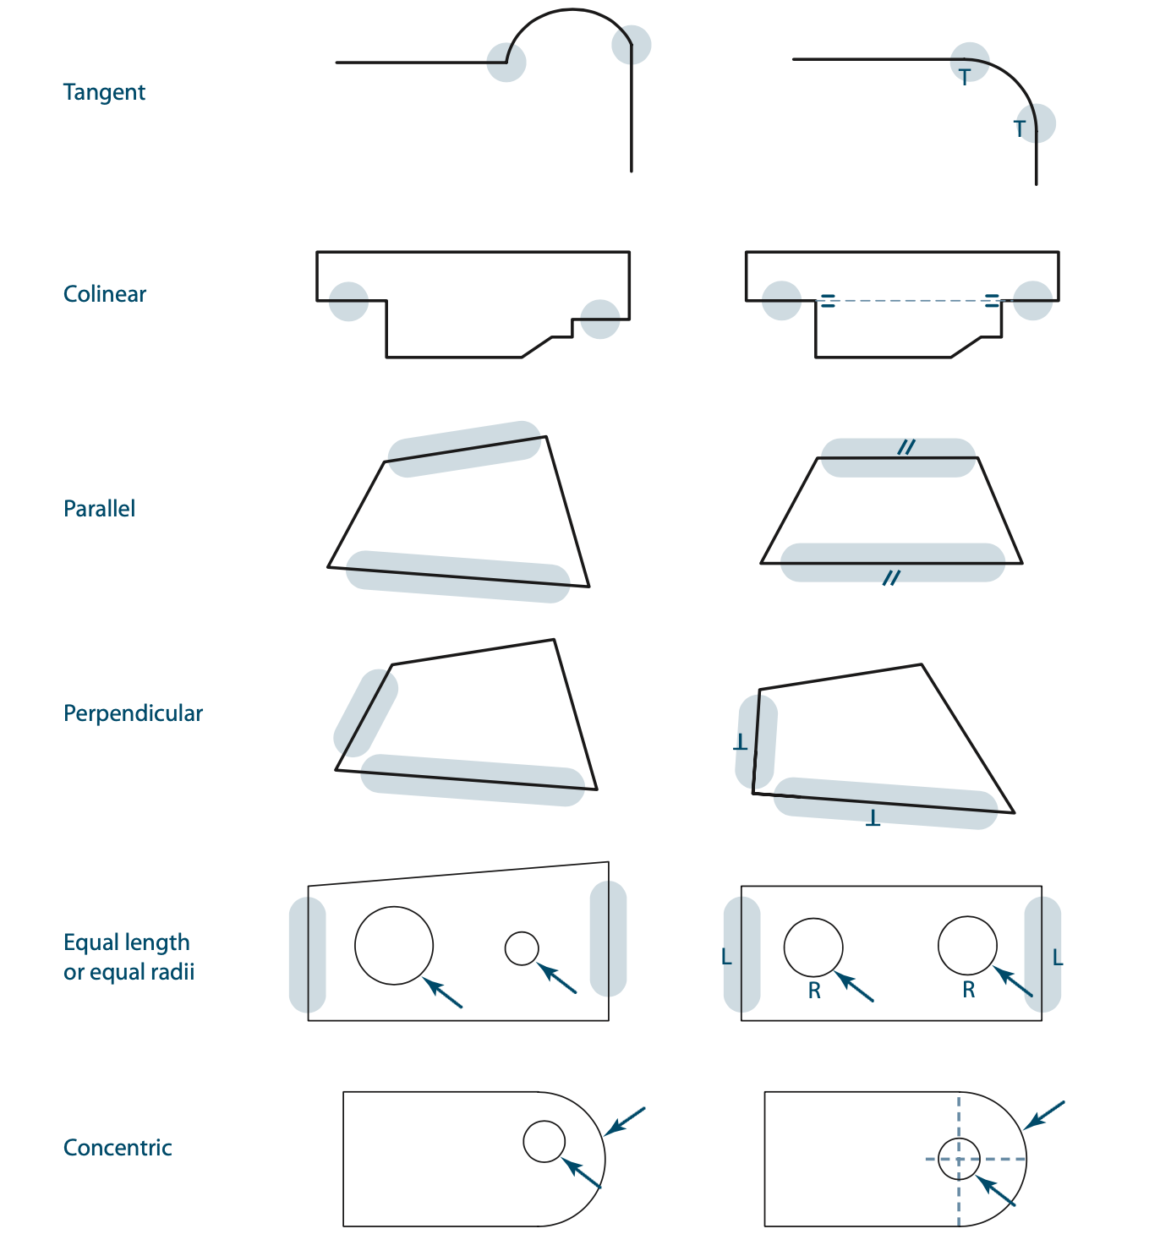
Geometric Constraints
Examples of geometric constraints -
Concentric
Point on line
Horizontal/Vertical
Tangent
Colinear
Parallel
Perpendicular
Symmetric

Slide 8
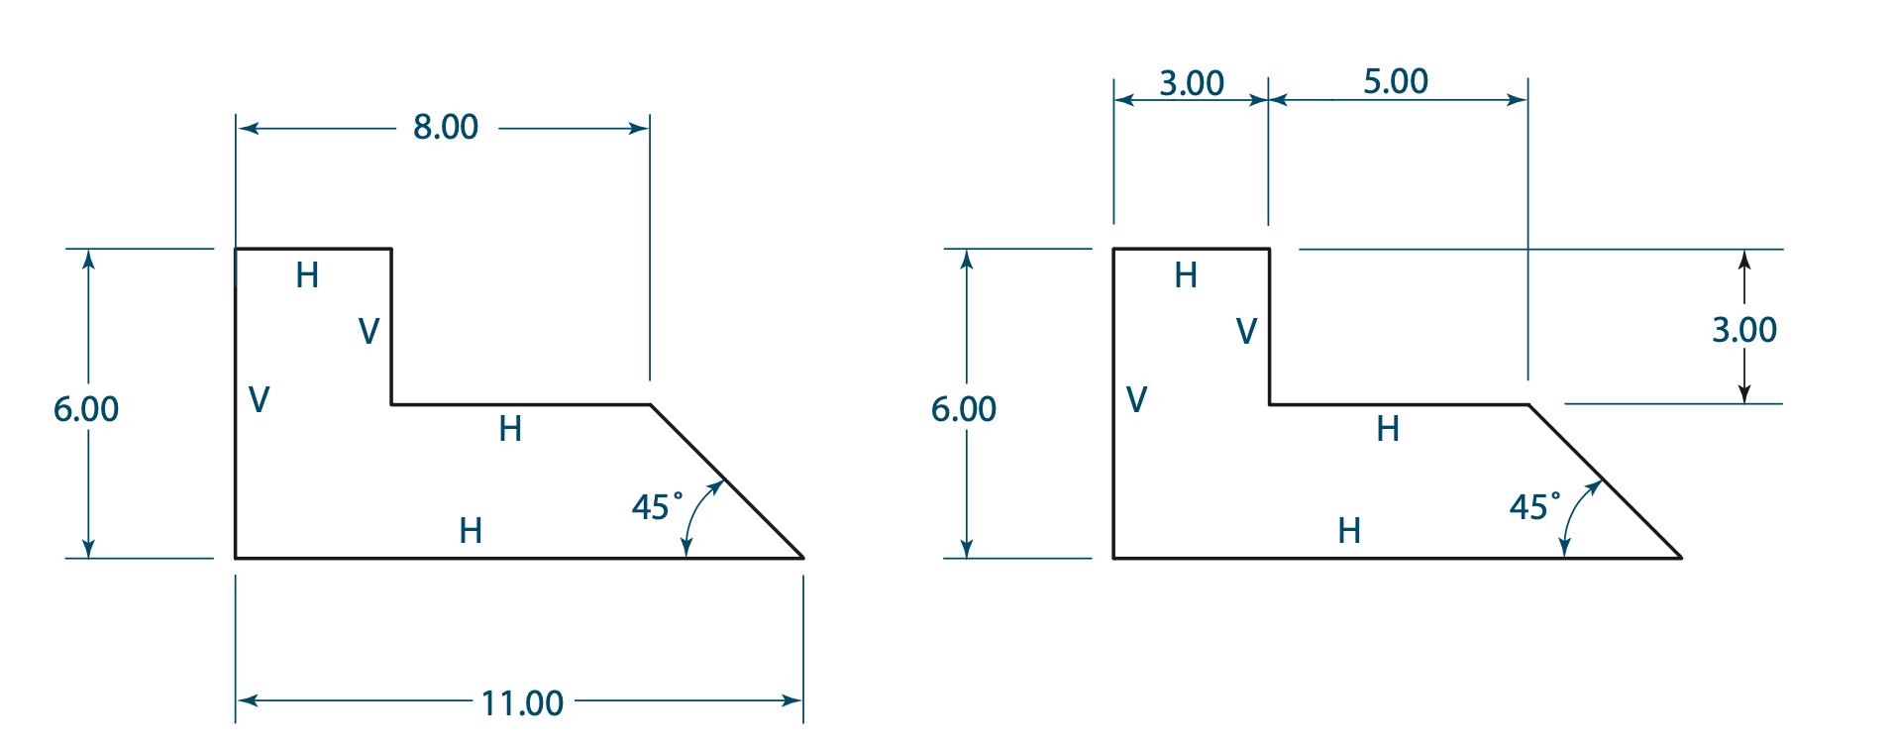
Dimensional Constraints
Measurements used to control the size and position of sketch entities
A set of constraints is not unique

Slide 9
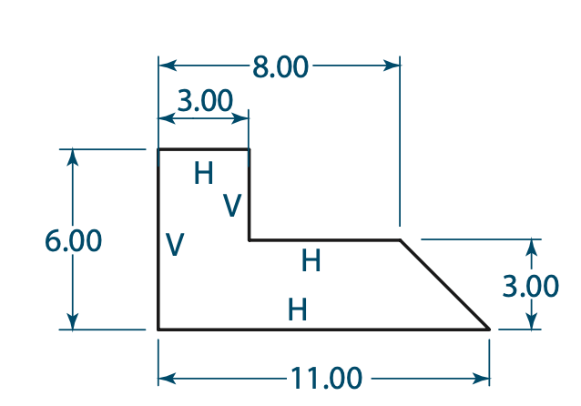
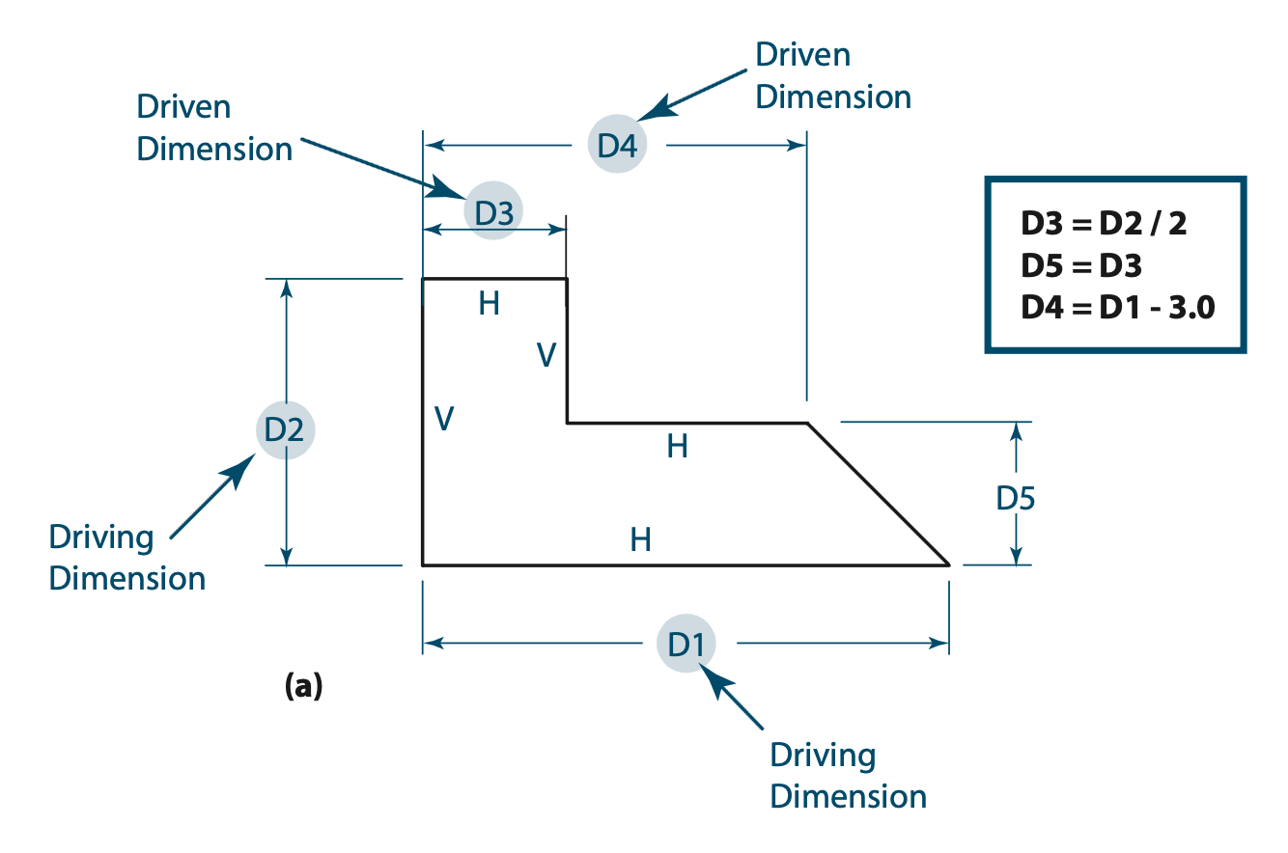
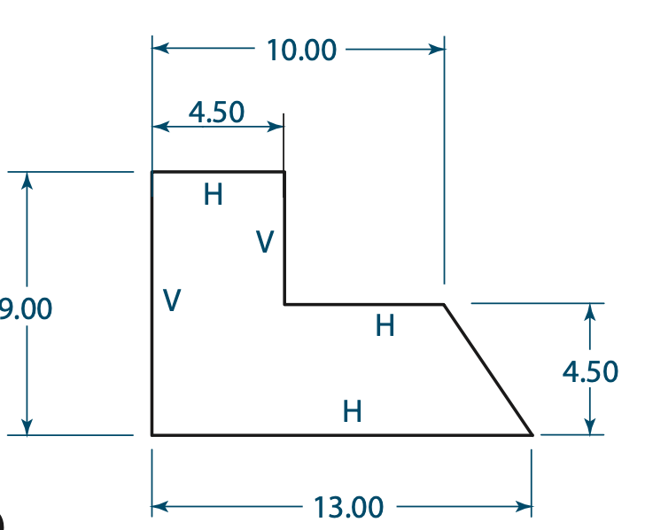
Associative and Algebraic Constraints
relate one dimension to another using variables

Slide 10
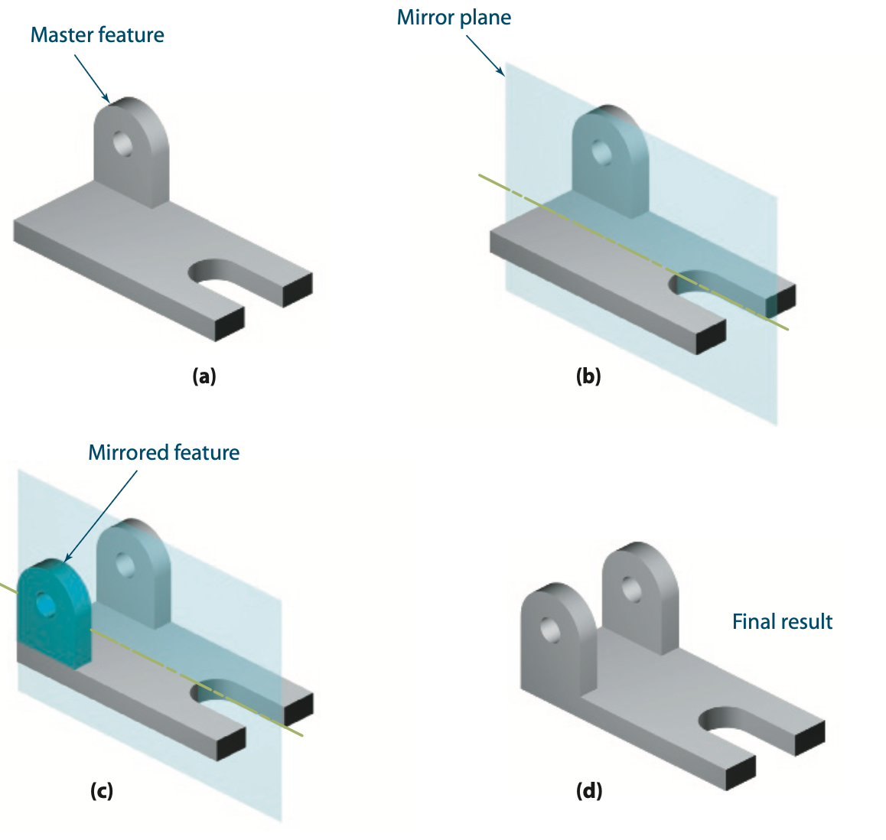
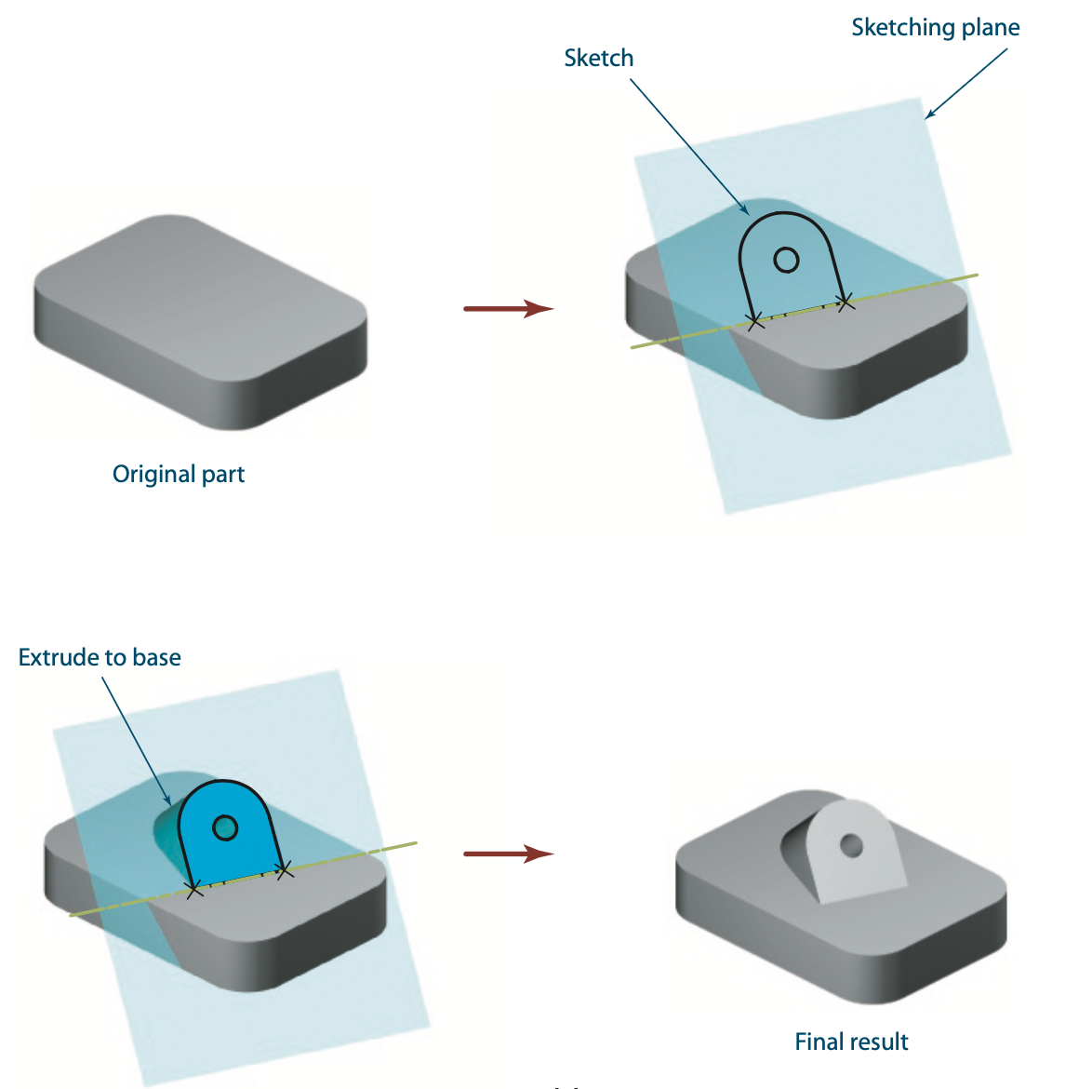
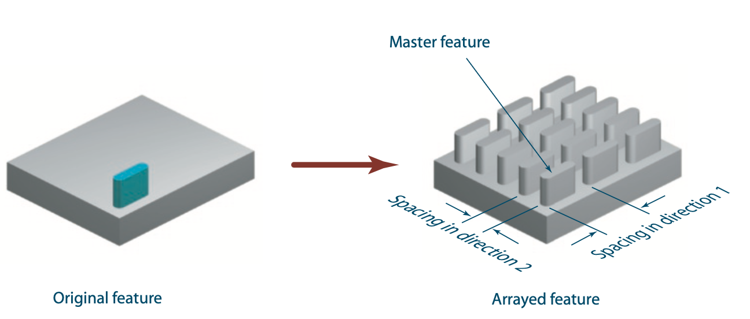
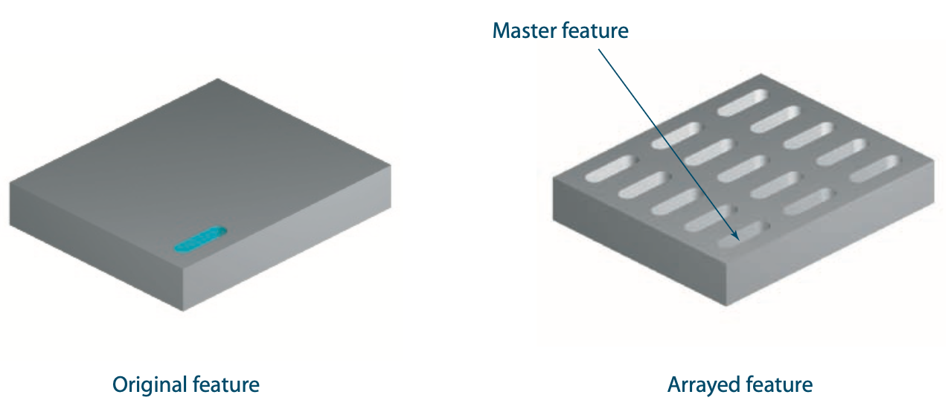
Further Complexity
Mirror
Different Sketching Plane
Array

Slide 11
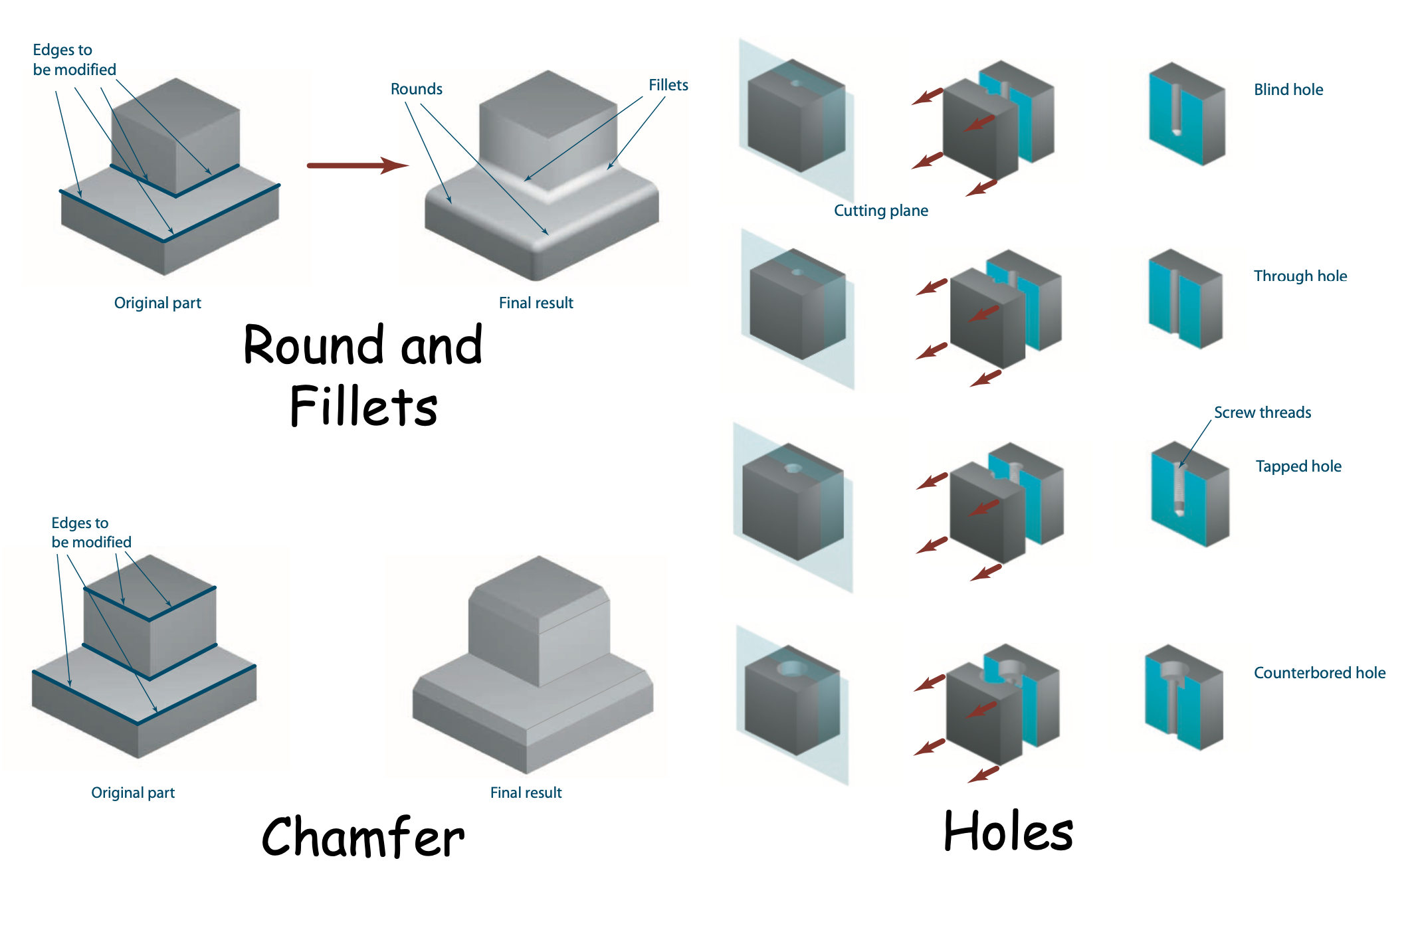
Feature-based Modeling

Slide 12
© Ankit Jain
All rights reserved.
You may not make copies or disseminate this material in any form without my express permission.

